Slide 1
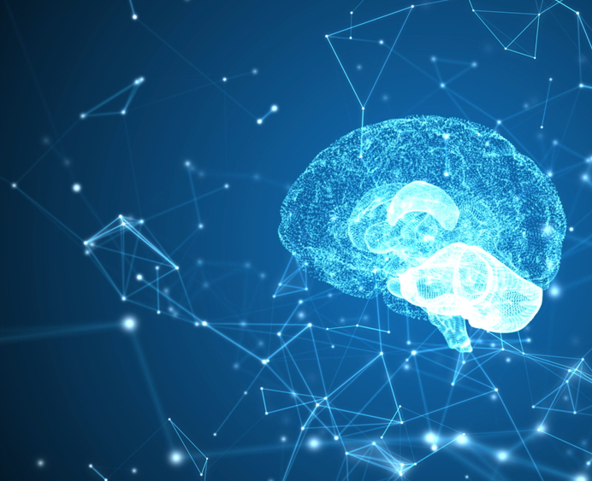

Advancements in
the Development of Novel Neurosteroids for Treatment of Brain Injury
Arrowhead Conference
June 7, 2022

Slide 2
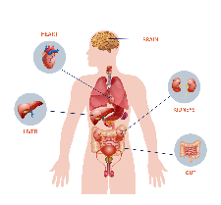
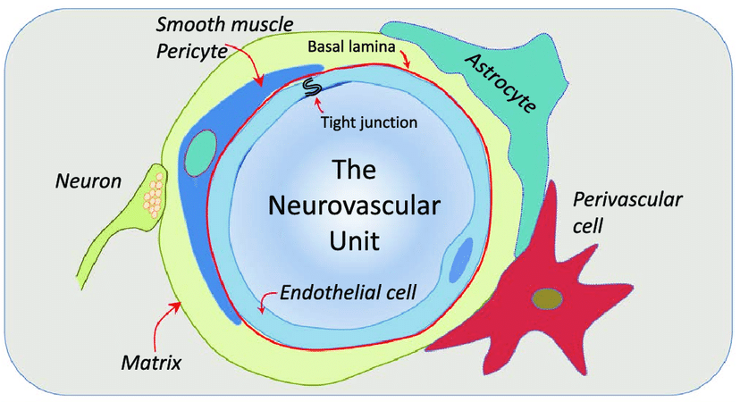
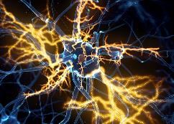
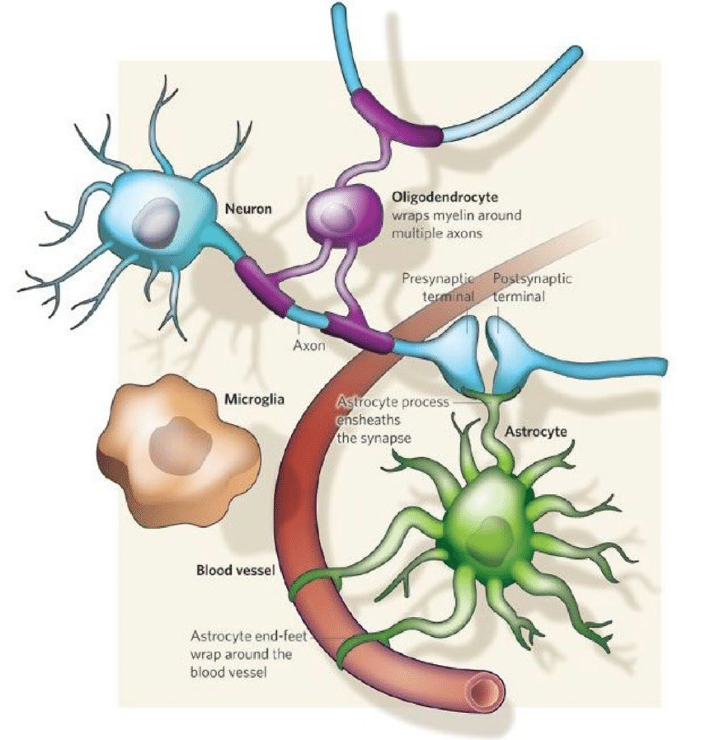
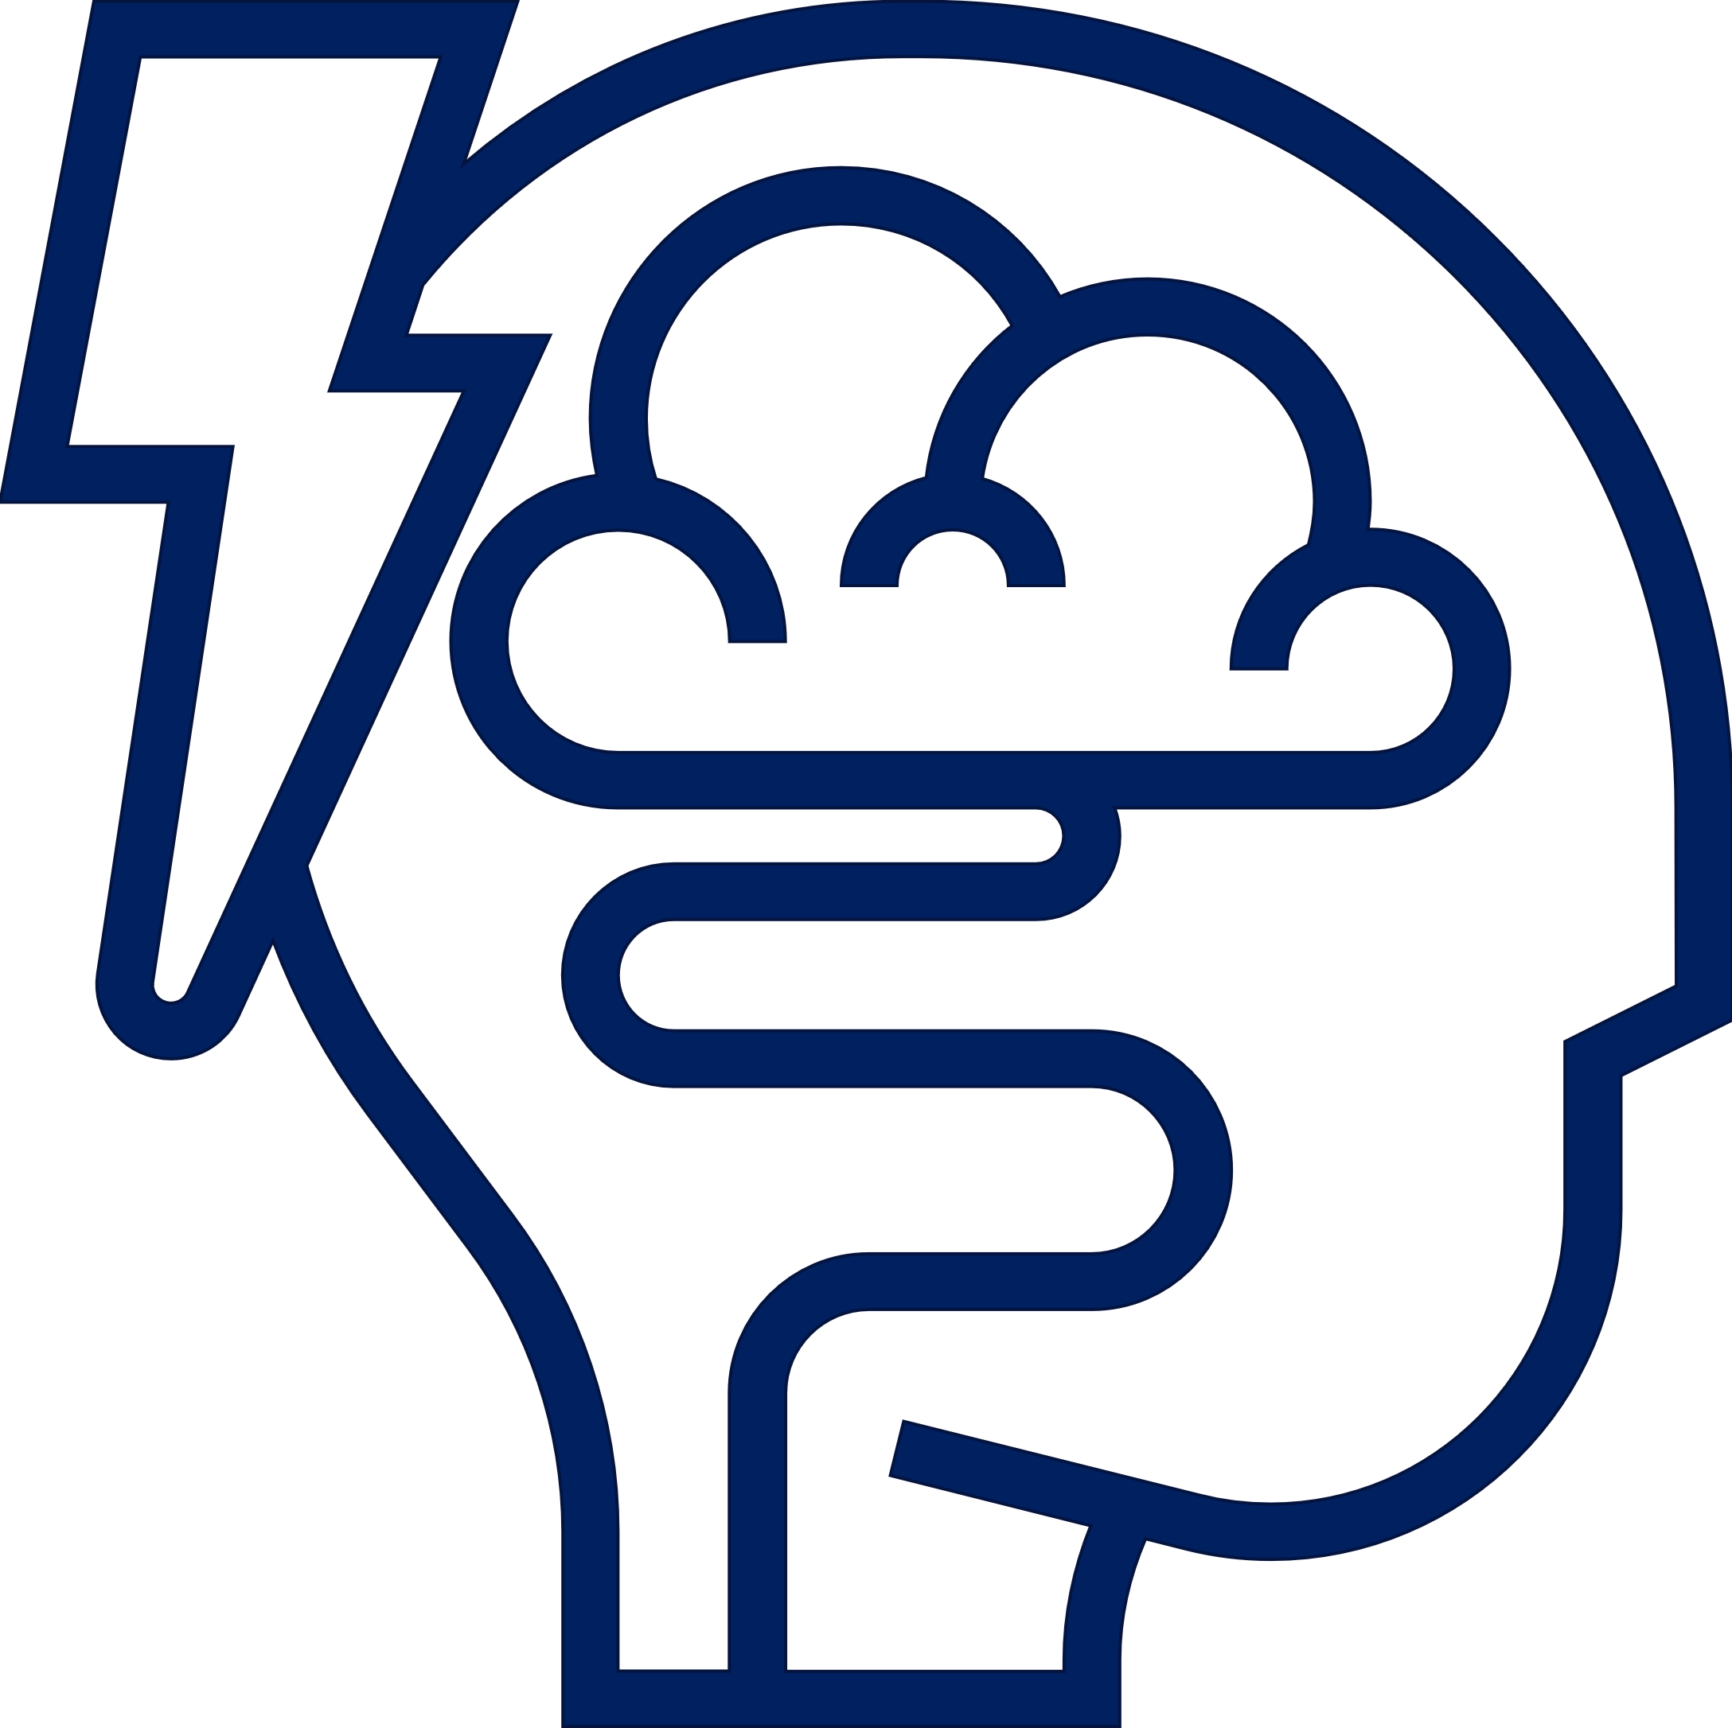
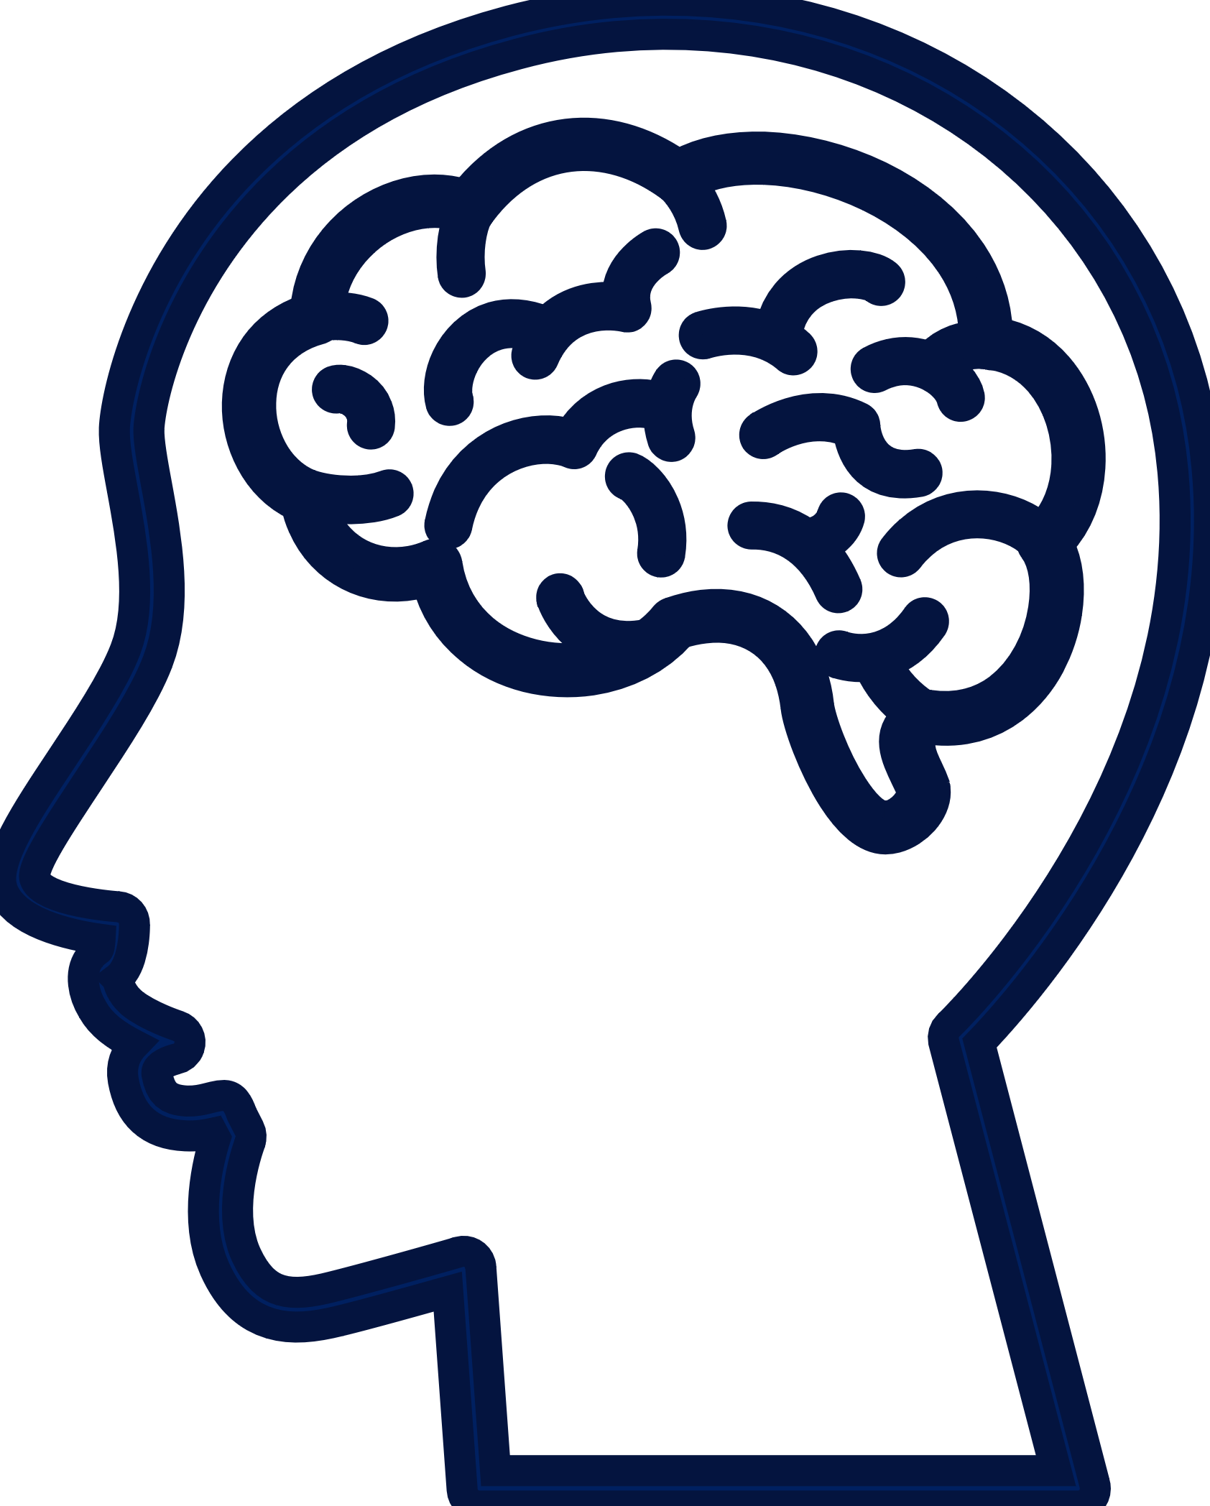
Brain Injury (Stroke and TBI) Triggers Neuroinflammation and Systemic Dysfunction Throughout Acute and Chronic Recovery Phases
Common Brain Pathological Sequelae
Systemic and
Peripheral
Organ Systems
Neurovascular/
BBB Disruption
Neuroinflammation
Cell Death and
Dysfunction
Stroke: Vascular in origin, affects brain parenchyma and vasculature
TBI: External injury damaging brain and vasculature
Note: Modified based on Maki et al., 2013

Slide 3
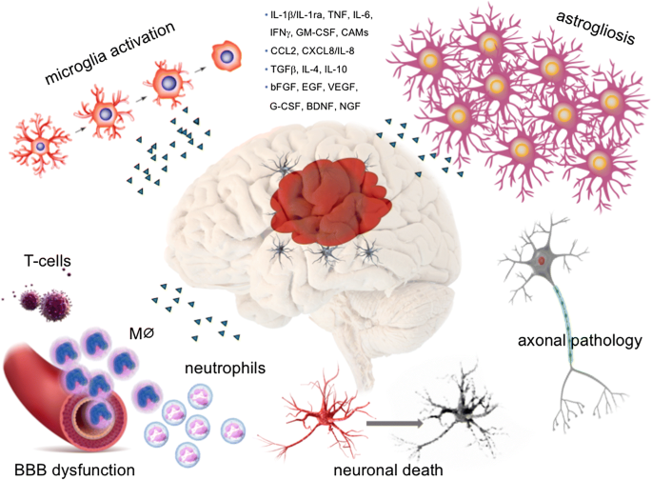
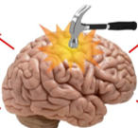
Brain Injury: Multiple Causes / Multiple Effects
Causes of Brain Injury
Traumatic – MVA, Sports, Assaults, Falls, Military
Non-traumatic – Stroke, Chemotherapy, Virus, Hemorrhage
Complement
activation Inflammation & ROS generation
Cerebral edema Cerebral hypoxia and ischemia Cerebral metabolic impairment Cerebral vasospasm Increased intracerebral pressure
Excitotoxicity
Cell death
BBB damage
Increased Glutamate
Mitochondrial dysfunction Impairment of Glucose metabolism
Despite the huge unmet need, there are no neuroprotective medications

Slide 4
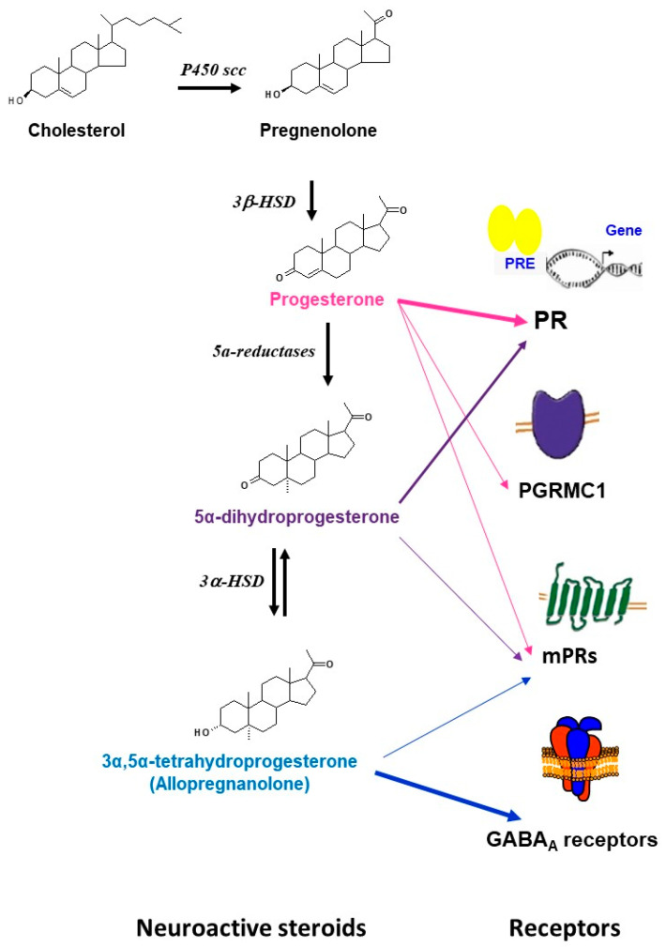
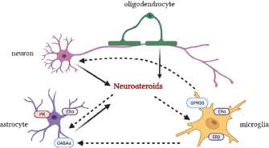
Lessons from Nature: Neurosteroids
Neurosteroids: Endogenous response to brain injury (Guennoun et al., 2015 and 2020)
Act on multiple receptor types
Receptor expression changes
Enzymatic changes
Note: Xu et al., J. Neurochem. 2021; Guennon, Int. J. Mol. Sciences 2020

Slide 5
Neurosteroids And Neuroprotection
Pathophysiology of Brain Injury
Neurosteroid Mechanisms in Brain Injury
Inflammatory Cytokines
Reduces Inflammatory Cytokines
Demyelination
Receptor activation
Remyelination
Sigma receptor blockade
Pro Apoptotic cascade
Vasogenic Edema
Increases Bcl2 pAKTP
Vasogenic Edema
TBI/
Ischemia
Neuro-steroid
Apoptosis
Cerebral Edema
Reduce Apoptosis
Reduces Cerebral Edema
Mitochondrial Uncoupling
Cytotoxic Edema
Mitochondrial Recoupling
Cytotoxic Edema
Free radicals & lipid peroxidation
Reduced GABA
Reduces free radicals & lipid peroxidation
Enhances GABA
Excitotoxic cascade
Blocks Excitotoxicity
Strong potential to improve function in acute through chronic phases of recovery
Note: Adapted from Sayeed and Stein, 2009

Slide 6

Neurosteroids gaining traction as CNS therapeutics
Recent approvals
Zulresso™ (brexanolone IV form of allopregnanolone) for PPD (March, 2019)
Ztalmy™ (ganaxolone) for a rare epilepsy disorder (March 2022)
Others in development
Zuranolone Phase 3+ for Major depressive Disorder and other forms of depression
PH94B in Phase 3 for social anxiety disorder
SAGE-324 in Phase 2 for essential tremor
SAGE 718 in Phase 2 for neurodegenerative disease cognitive impairment

Slide 7
Progesterone Represented A Compelling Approach For Neuroprotection
Progesterone was the prototype of a multi-targeted neuroactive,
brain-penetrant steroid
Decades of published evidence
>300 preclinical reports in TBI and stroke pointed to therapeutic potential
Known U-shaped dose-response relationship (i.e. higher doses not efficacious)
Pivotal human trials held in severe TBI-- ProTECT and SYNAPSE¹ – did not succeed for many addressable reasons²
Repurposing did
not follow standard drug development tenets:
Solubility and formulation for IV product
Dose selection & regimen not based on PKPD
Early use of biomarkers
1. ProTECT and SYNAPSE study publications; 2. Stein, Brain Injury 29: 1259-1272, 2015; Schumacher et al., J. Steroid Biochem. Mol Biol. 160: 53-66, 2016; ce: See references

Slide 8
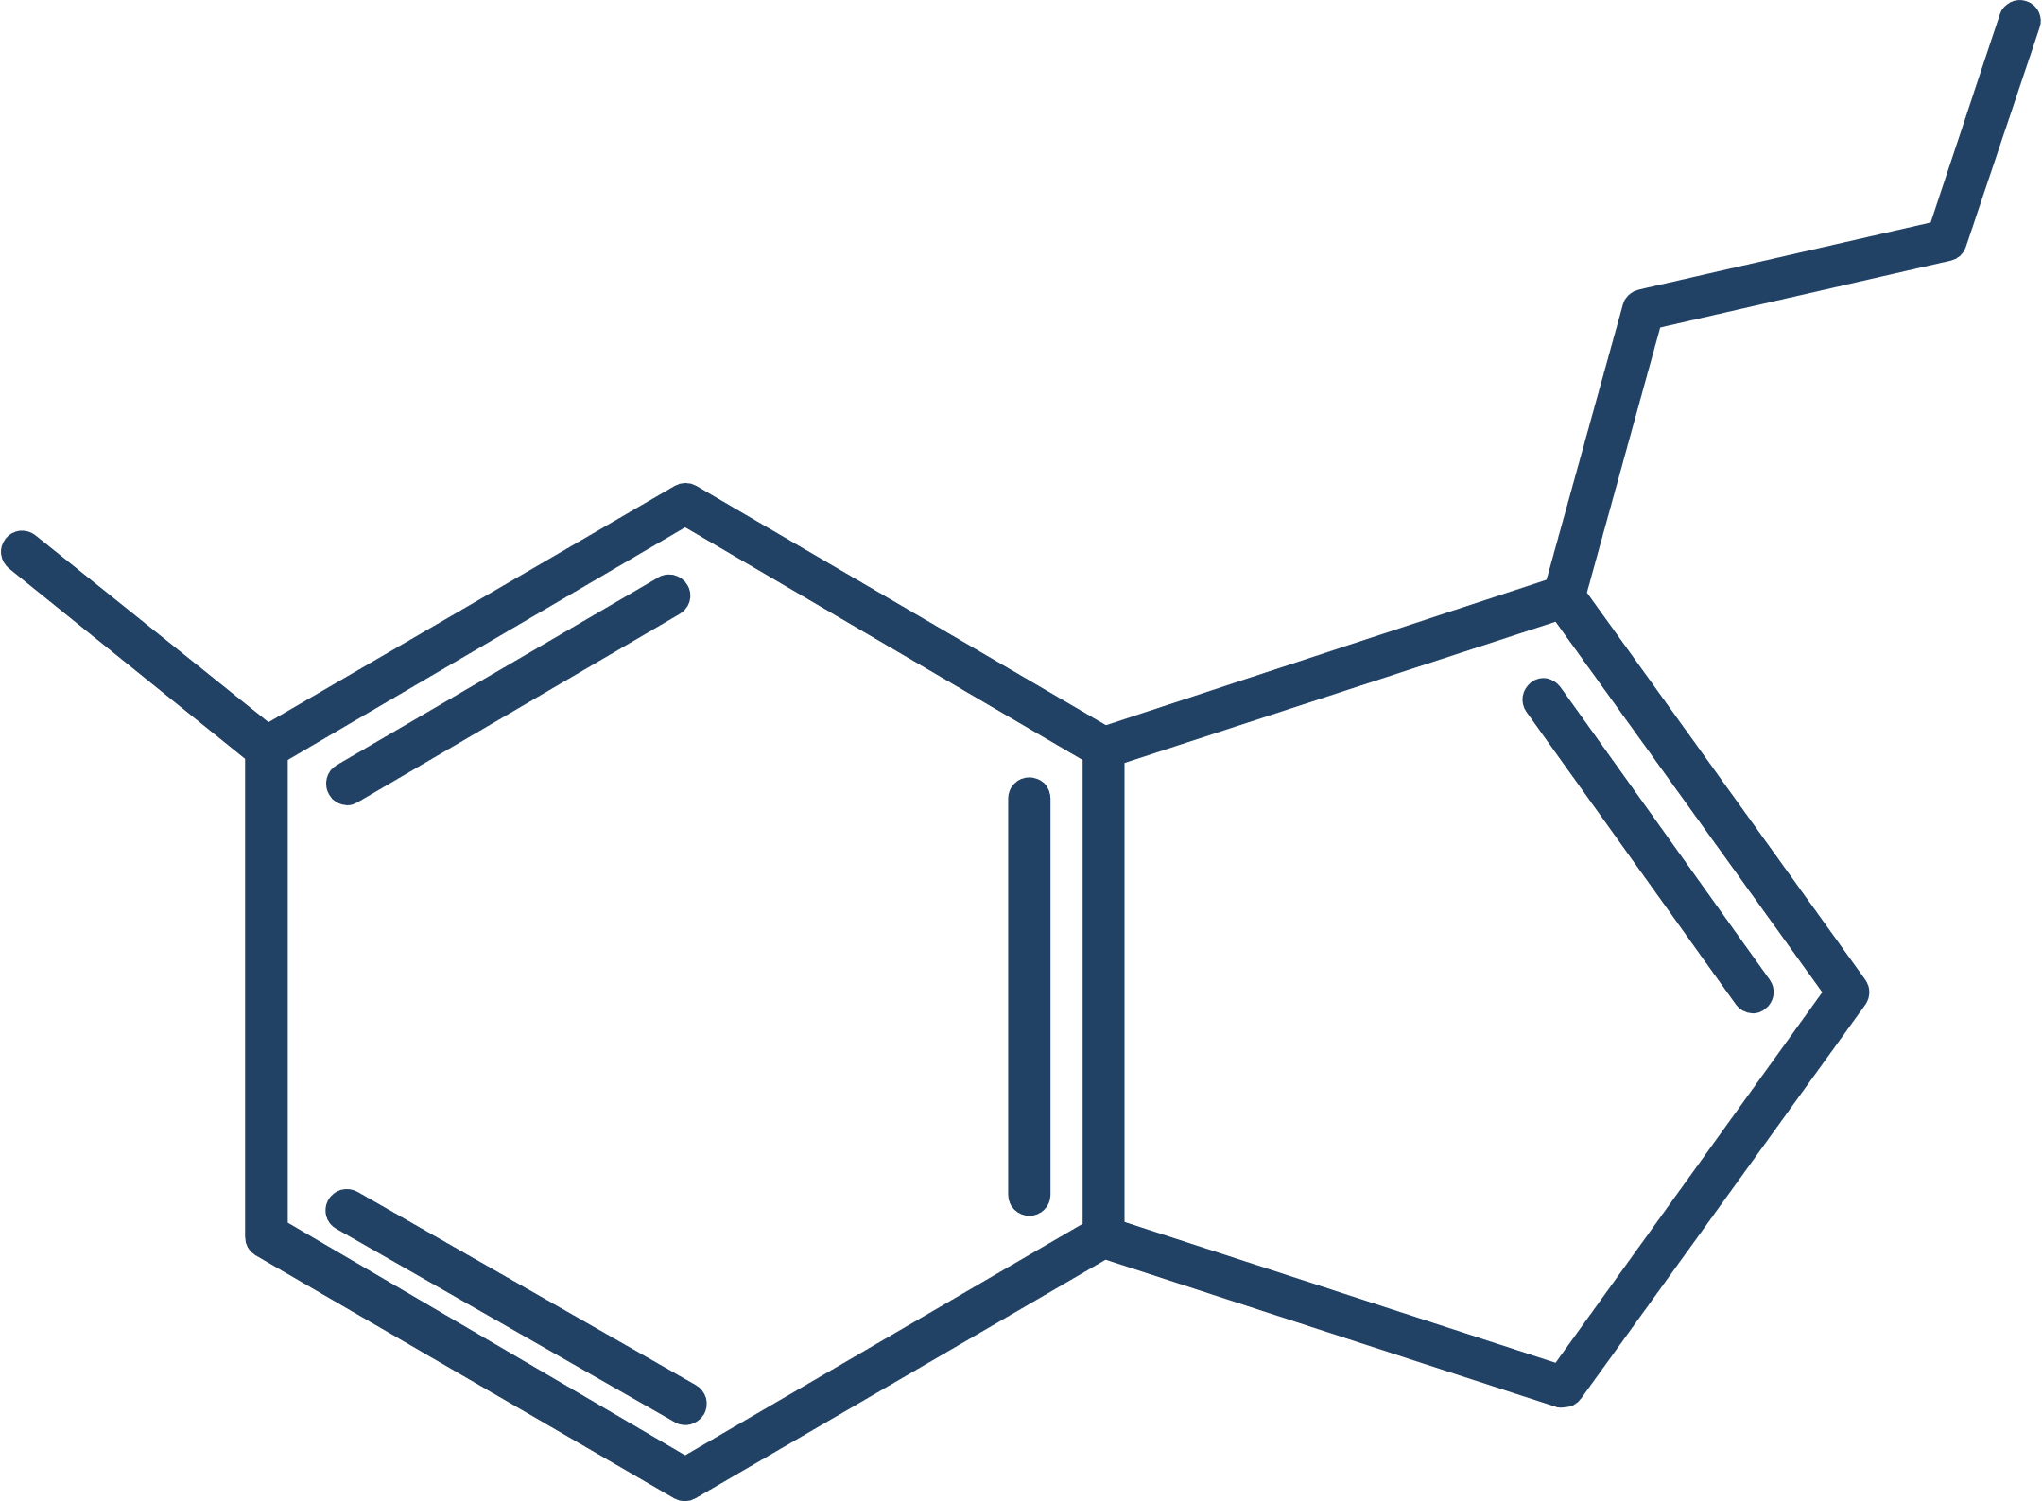
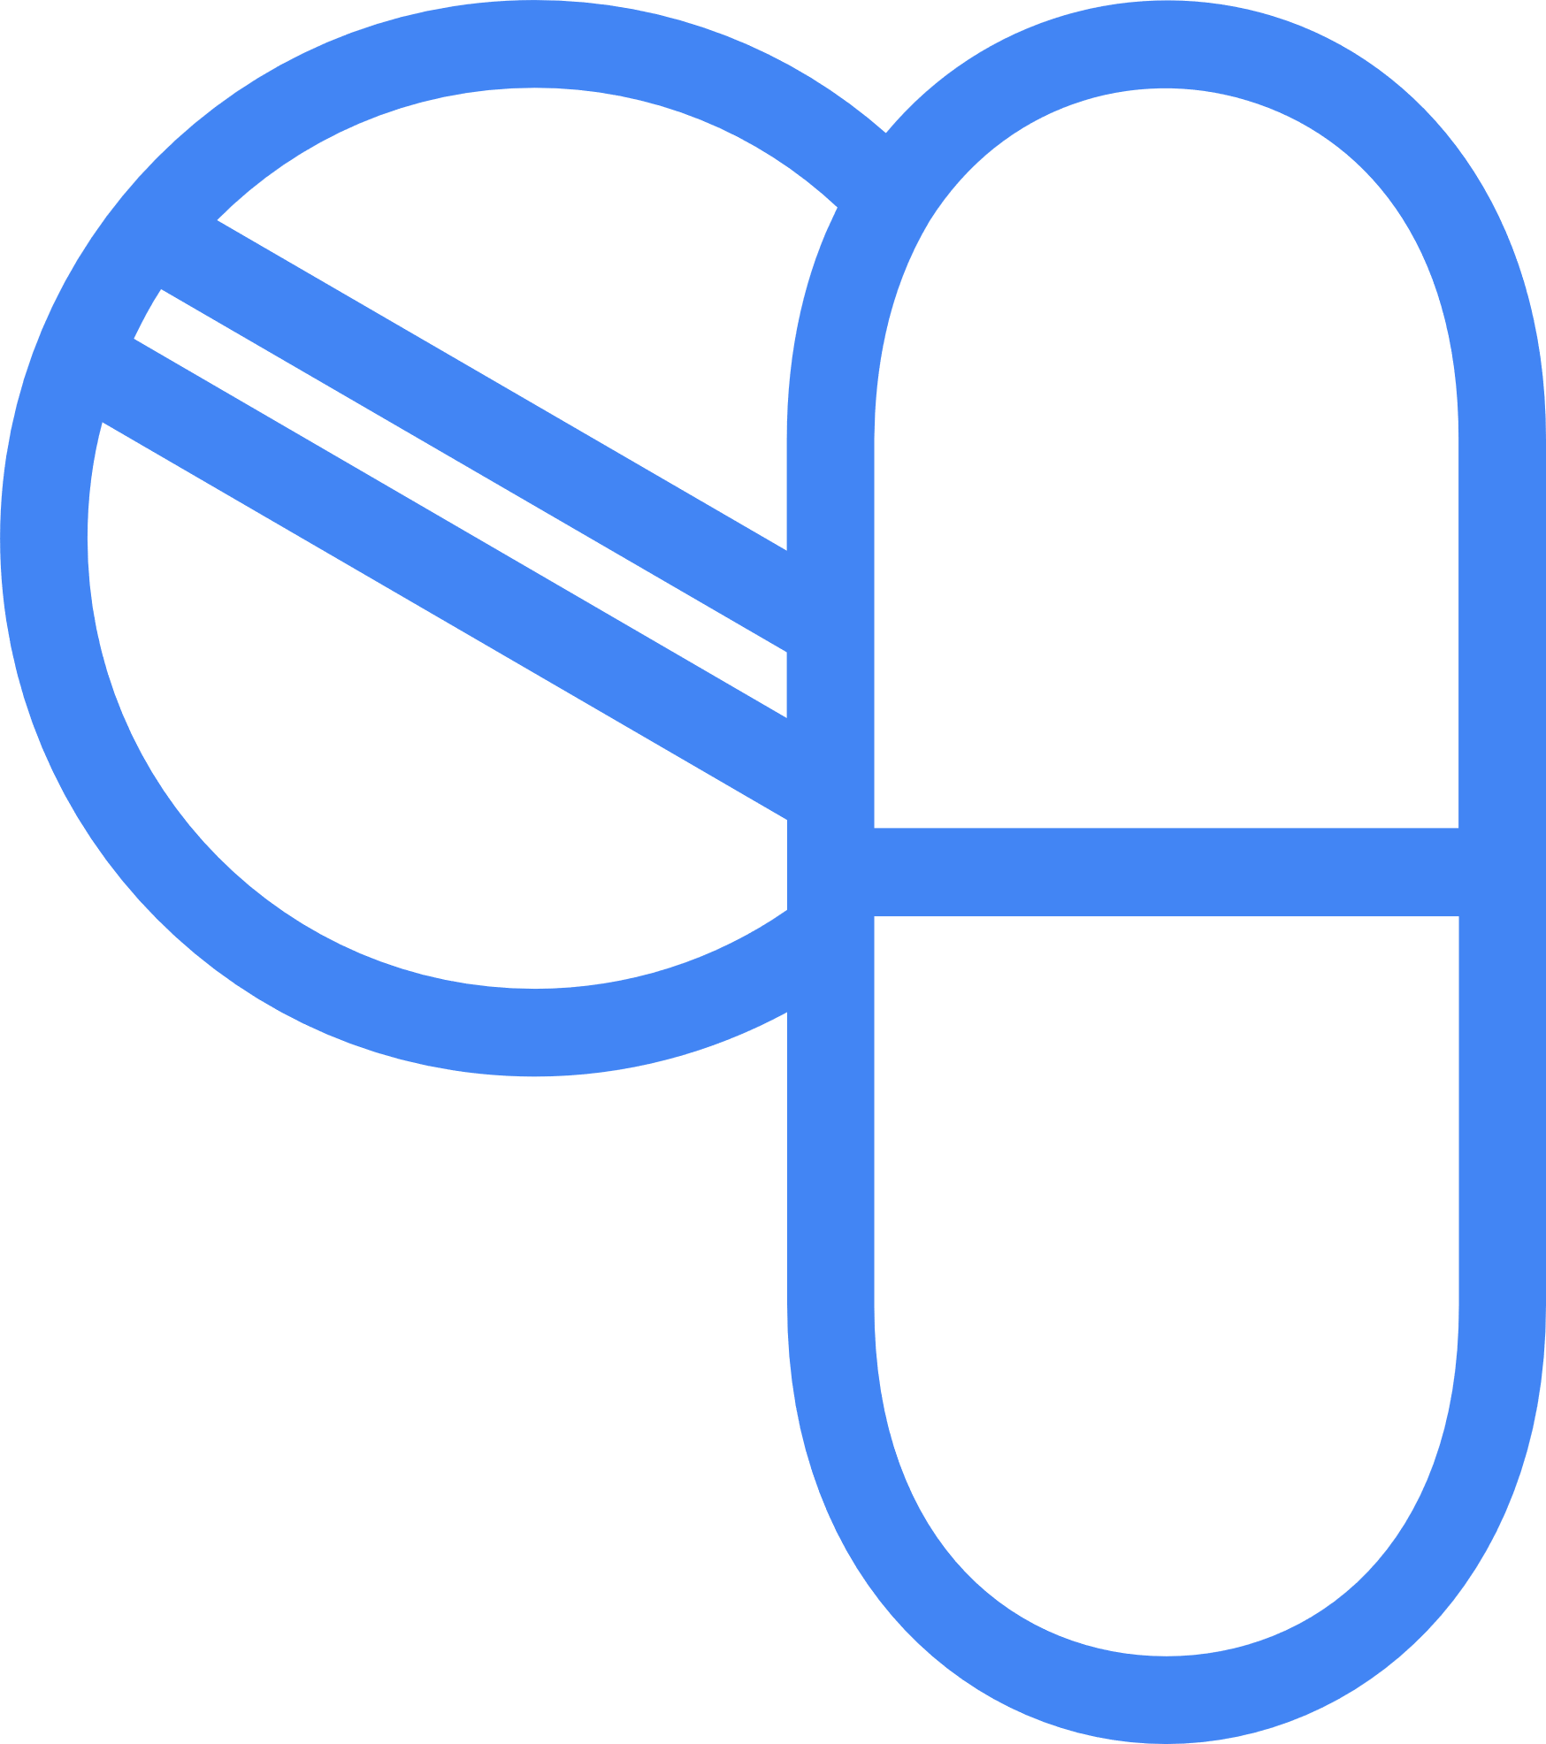

A Superior Multi-targeted Drug Would Be A Major Advancement For Treating Brain Injury
Emory neuroscientists challenged their world-class medicinal chemistry colleagues at the Emory Institute of Drug Development (EIDD) to engineer a solution
Active Novel
Neurosteroid
(EIDD-036 or
NTS-105)
High potency
Novel Prodrug (EIDD-1723 or NTS-104) with aqueous solubility
Important Leads are now in development at NTS

Slide 9
Two Novel Chemical Entities With Prodrug – Neuroactive Drug Relationship
Prodrug
NTS-105
High aqueous solubility and stability
Enhanced pharmacologic properties relative
to progesterone
Converts rapidly to NTS-105 in plasma
Crosses BBB and achieves pharmacologically important brain concentrations
Suitable for IV dosing
Conversion
Suitable for parenteral and non-parenteral dosing
Prodrug Moiety
Activates PR nuclear hormone receptor at
nanomolar potency
NTS-104
Neuroactive Drug
Source: NTS internal data

Slide 10
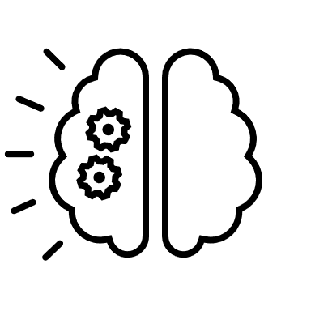
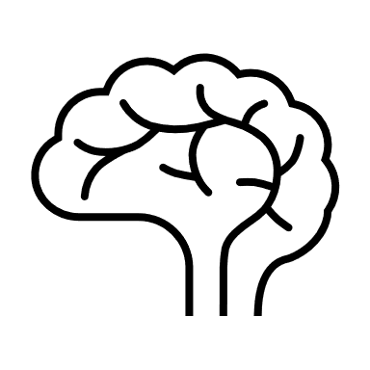
Brain NTS-105 Concentrations Engage Molecular Targets After Systemic Administration Of Efficacious Doses
Plasma concentrations
Brain concentrations
50% target engagement level based on free NTS-105 concentration
Protein binding >99%
Brain concentrations of free NTS-105 after IM dosing of effective NTS-104 doses are sufficient to bind to and activate progesterone receptors
Interactions evaluated against a broad range of safety-related receptors, enzymes and ion channels
Systemic and brain metabolism mediated
by neurosteroid
enzymatic cascade
Major metabolites of
NTS-105 have
been identified
Study CEAA-0026 CRL

Slide 11
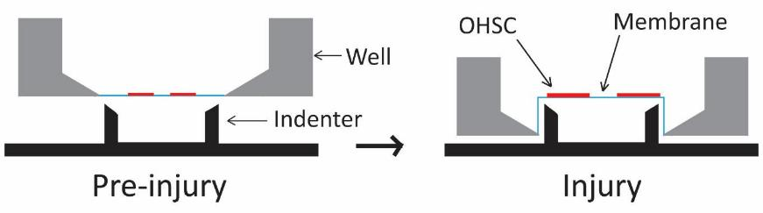
NTS-105 Reduces Cell Death In An Ex Vivo Model Of TBI
Substrate Strain Model
(Morrison Laboratory, Columbia U.)
High Potency Neuroprotection
1
Equibiaxial, homogeneous
strain field
Verifiable tissue biomechanics with
high-speed video
Continuous exposure starting at 1 h
PI cell death endpoint
at 96 h
* p < 0.05

Slide 12
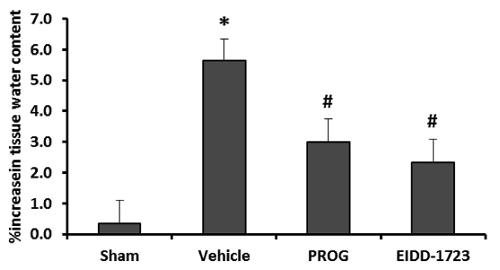
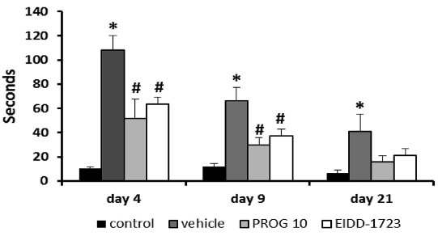
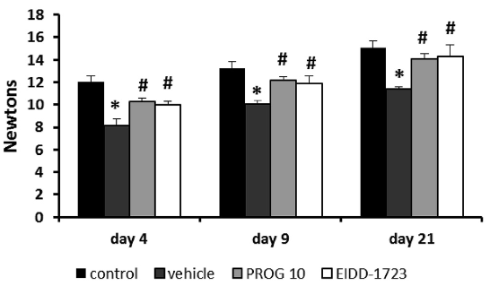
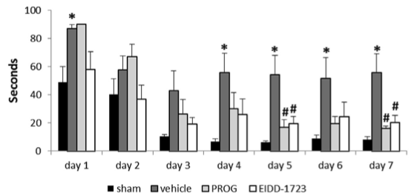
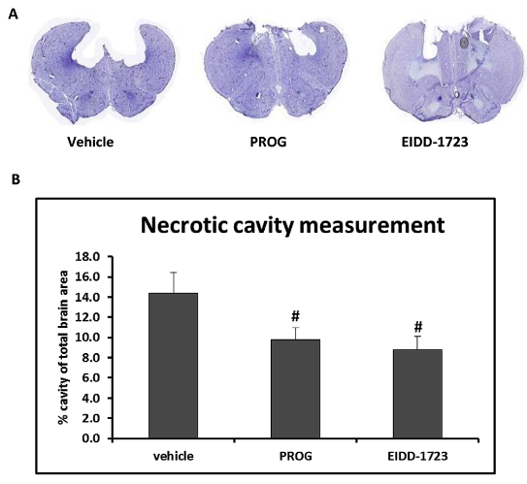
NTS-104 (EIDD-1723) Treatment Improves Functional Outcomes Following TBI
Edema level at 24th post TBI
CCI In Rat
Wali et al., 2016
Latency to remove sticker
Grip strength
n = 3
n = 4
n = 4
n = 4
n = 8 per treatment group
Latency to reach the platform in trial 2
Necrotic cavity measurement
n = 8 per treatment group
n = 8 per treatment group
n = 8 per treatment group
NTS-104 dosing post-TBI
1 h, 6h, 24 h, then once daily to 7 days (last 2 days tapered)
*p<0.05 CCI veh vs Sham; #p<0.05 drug vs veh

Slide 13
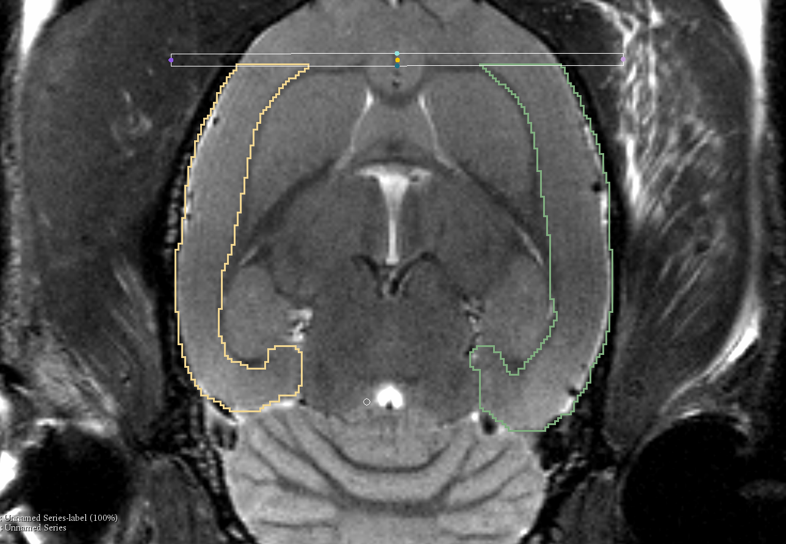
Moderate-Severe TBI Pilot Study: NTS-104 Reduced Edema and Improves Cognitive Outcome (Lateral Fluid Percussion In Rat)
Effect of NTS-104 administration
(IM 4, 10, 24, 48 hours after injury, n = 12)
Contralateral Cortex Volume
Ipsilateral Cortex Volume
Note: SUNY study – pilot TBI 090820

Slide 14
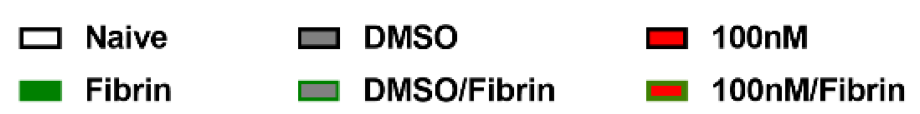
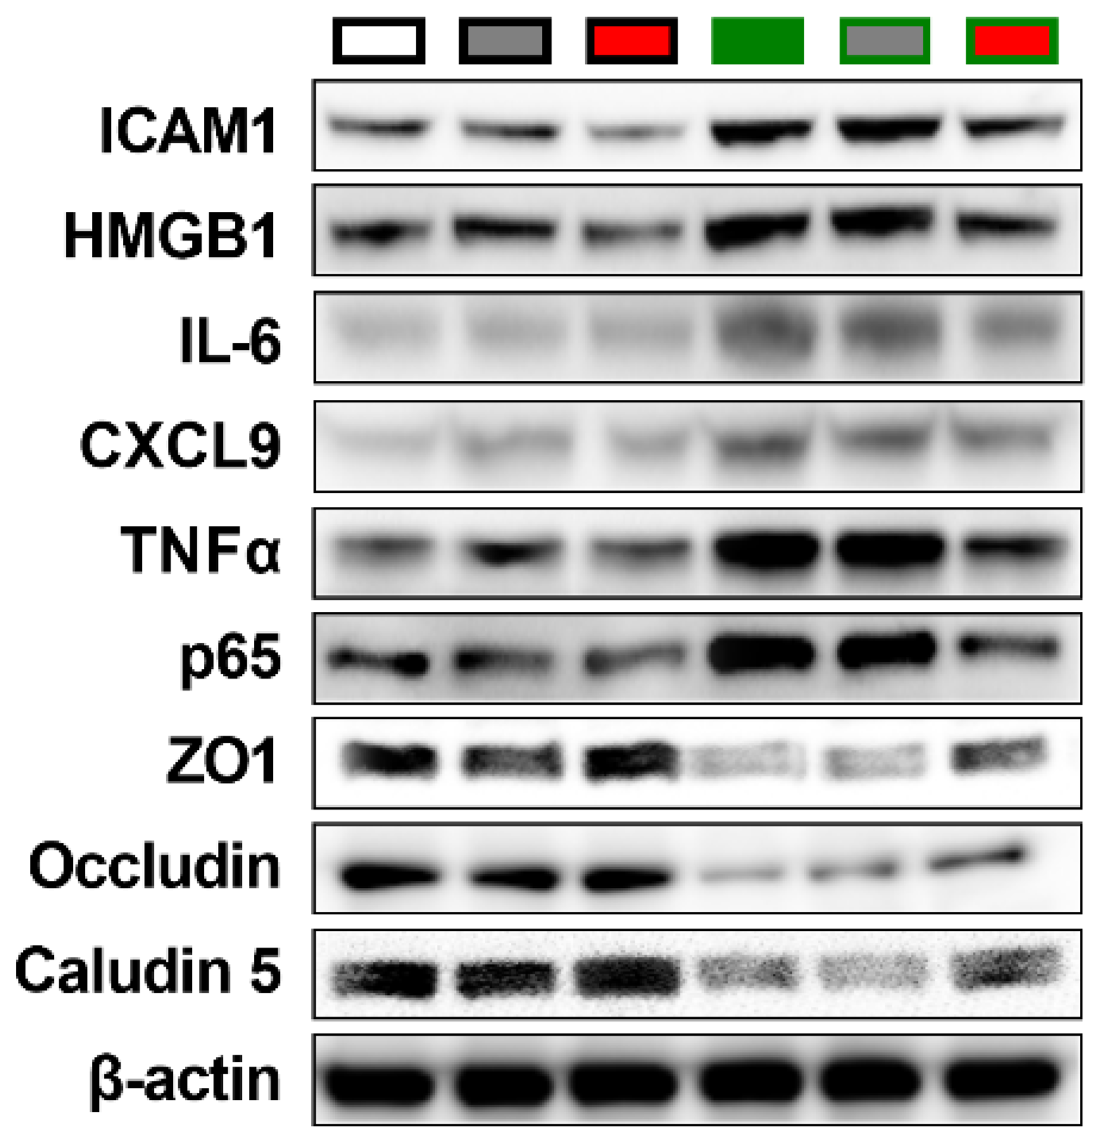
Cerebrovascular Fibrin Exposure: NTS-105 Reduced Markers Of Cerebrovascular Endothelial Cell Damage And Inflammation
Single mild TBI in SHR Rats—persistent fibrin accumulation, disrupted neurovascular function and neuroinflammation (Szarka et al., Int J Mol Sci, 2019)
In cultured cerebrovascular endothelial cells
Fibrin stimulates inflammatory marker and reduces tight junction protein expression
NTS-105 reduces inflammation induced
by fibrin
NTS-105 increases expression of tight junction markers reduced by fibrin
Inflammation
Source: NTS Study, M. Chopp

Slide 15
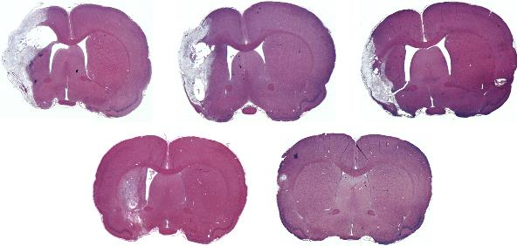
NTS-104 Improves Neurological Function After Ischemic Stroke
Dose ranging effects of NTS-104 in experimental stroke (Chopp Laboratory)
Study Design
  Embolic MCAo model
  NTS-104 dosed at 1, 3, 10, and 30 mg/kg
Dosing schedule: 4, 10, 24, 48, doses halved at 72, and again 96 h
15 rats per group
mNSS
1
7
14
21
28
Time after MCAO (d)
ATR
Vehicle
1 mg/kg
3 mg/kg
1
7
14
21
28
10 mg/kg
30 mg/kg
Time after MCAO (d)

Slide 16
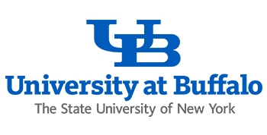
NTS-104 Treatment Dose-Dependently Reduces Circulating And Cortical IL-6 Acutely Following Ischemic Stroke
IL-6 concentration in plasma
IL-6 concentration in cerebral cortex
Vehicle
5 mg/kg
20 mg/kg
**
**
***
**
Modulates a host of proinflammatory cytokines as well as complement proteins
n = 5/group; Dosing at 6 h after initiation of ischemia
2. p < 0.01 vs. vehicle; 3. p < 0.001 vs vehicle

Slide 17
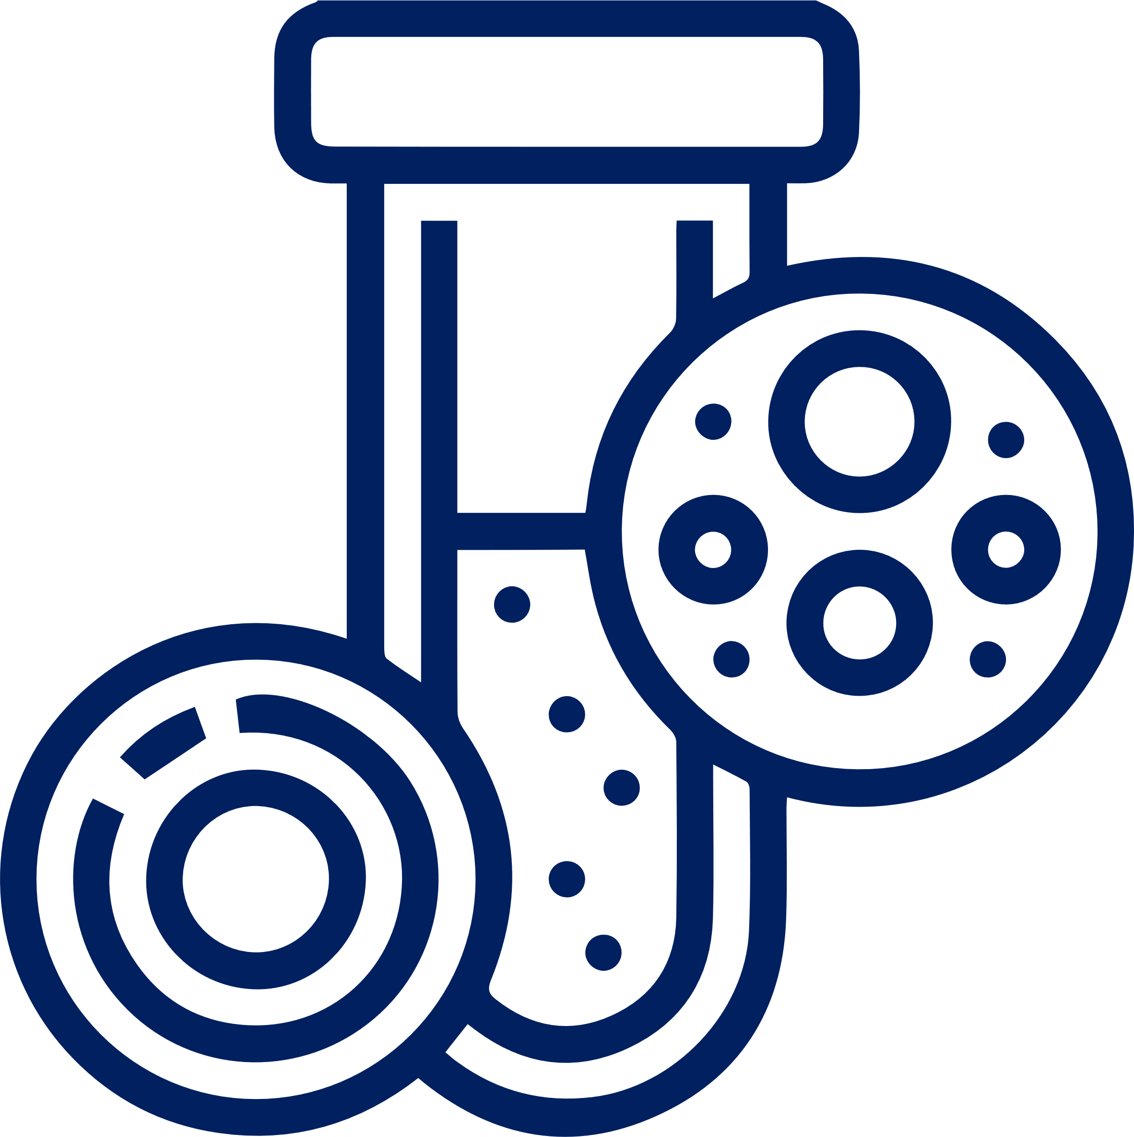
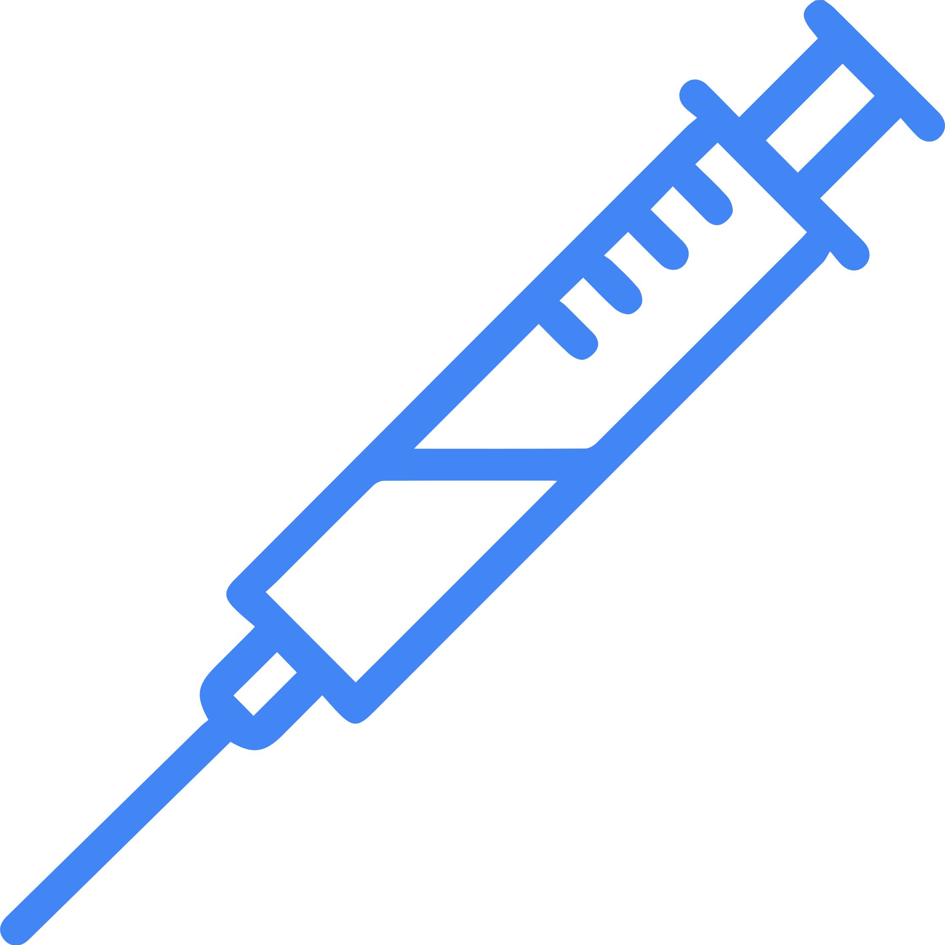
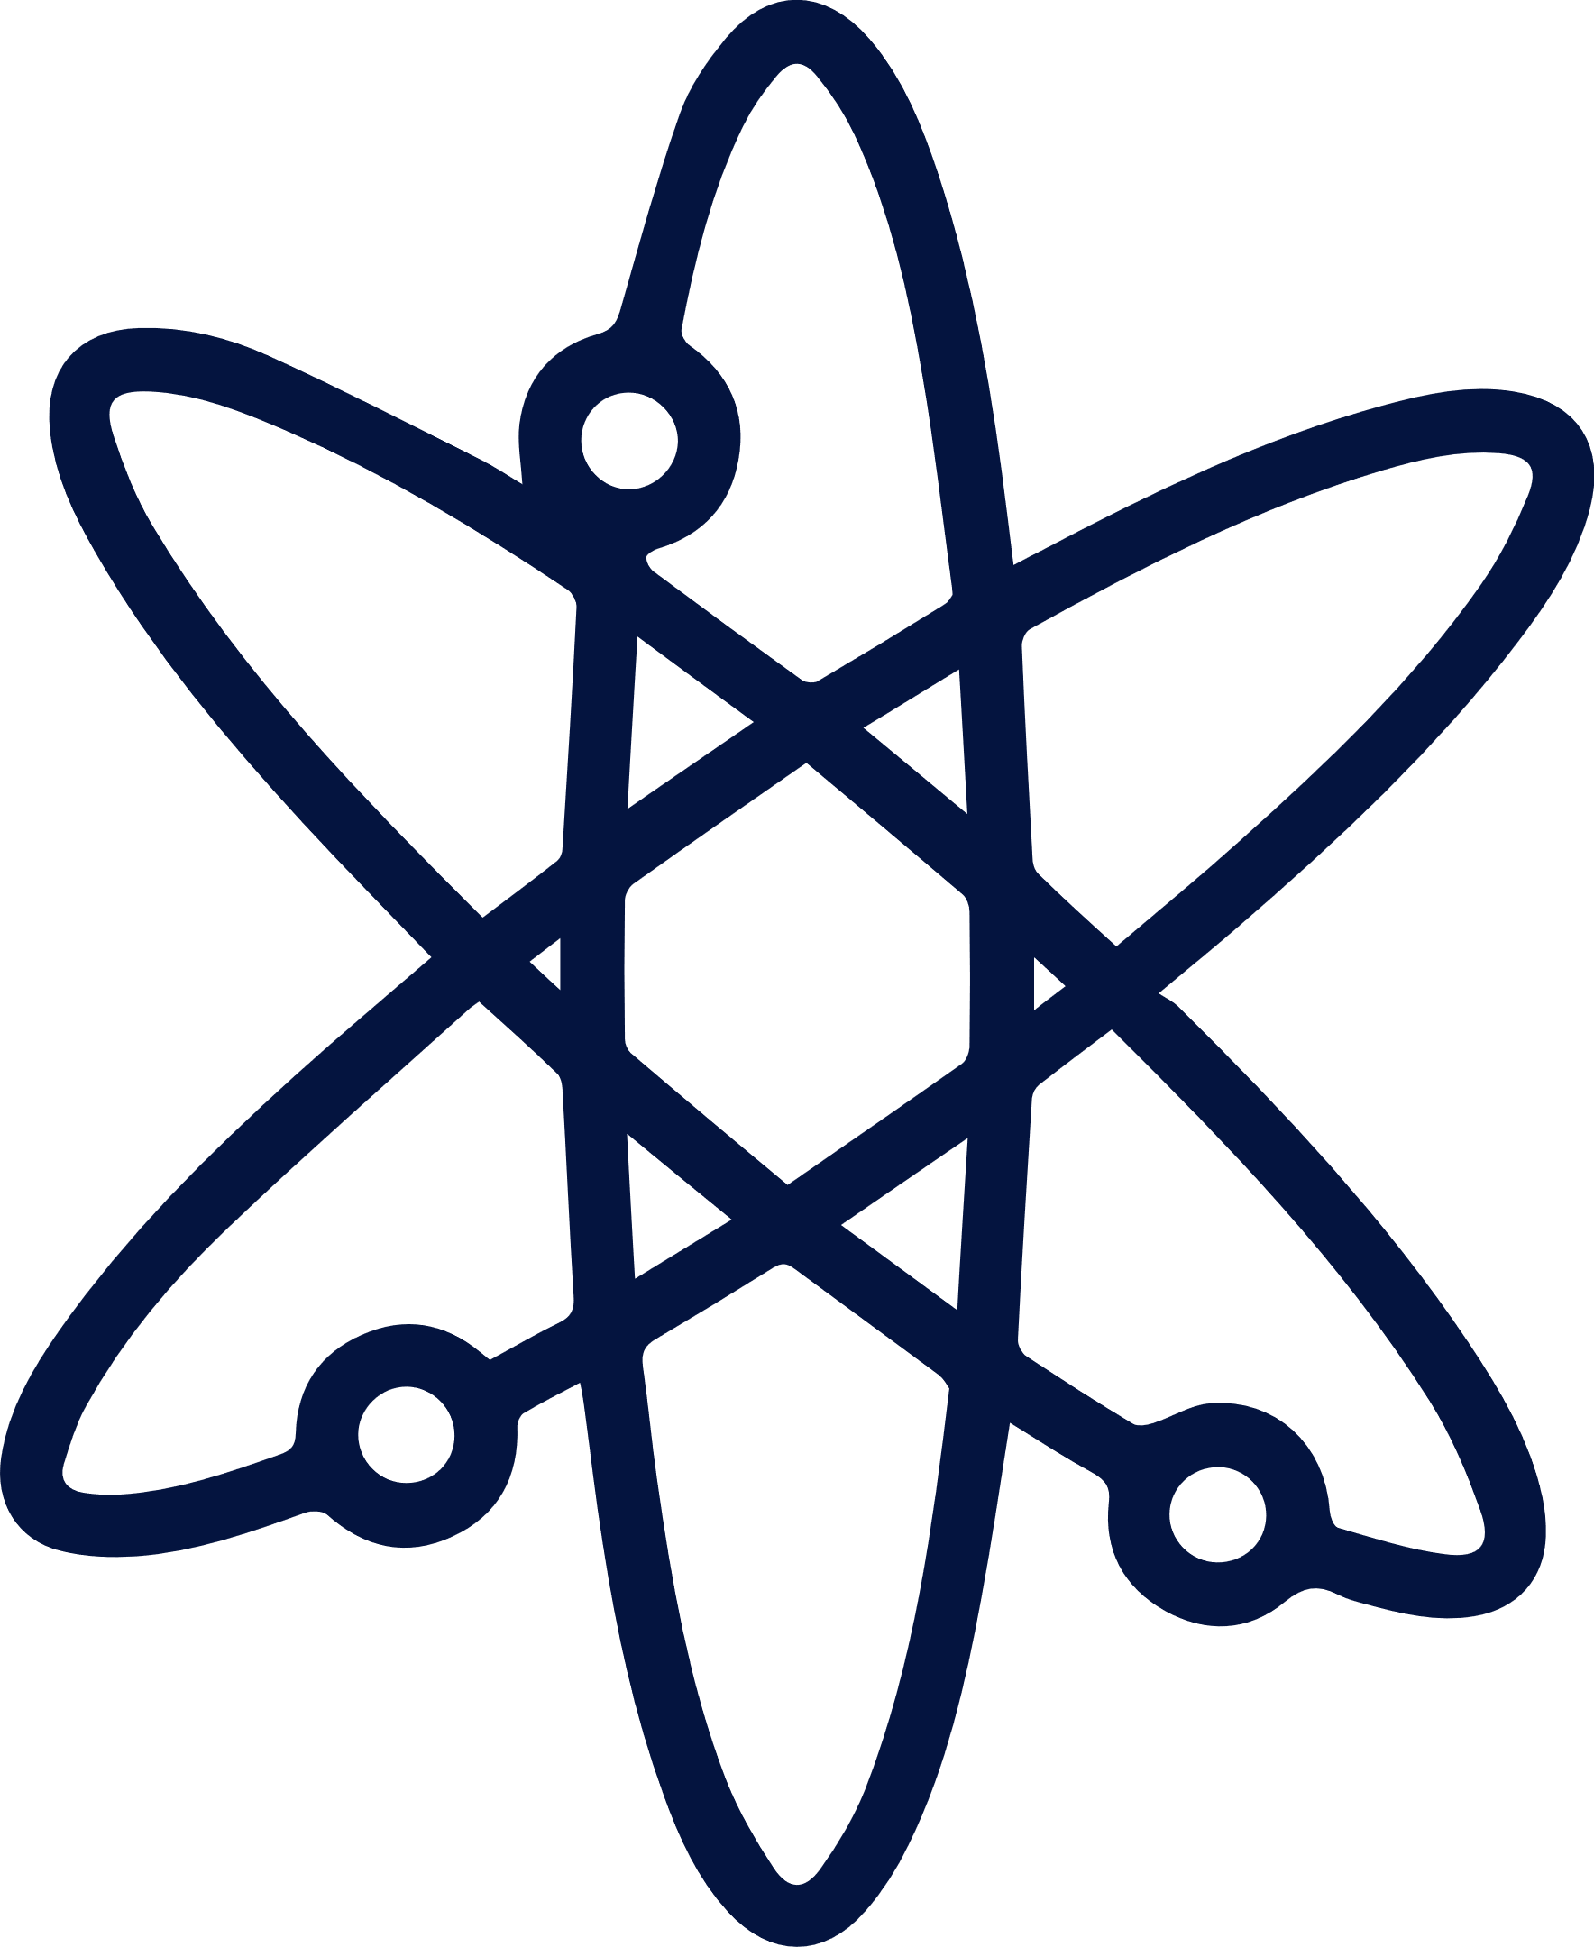

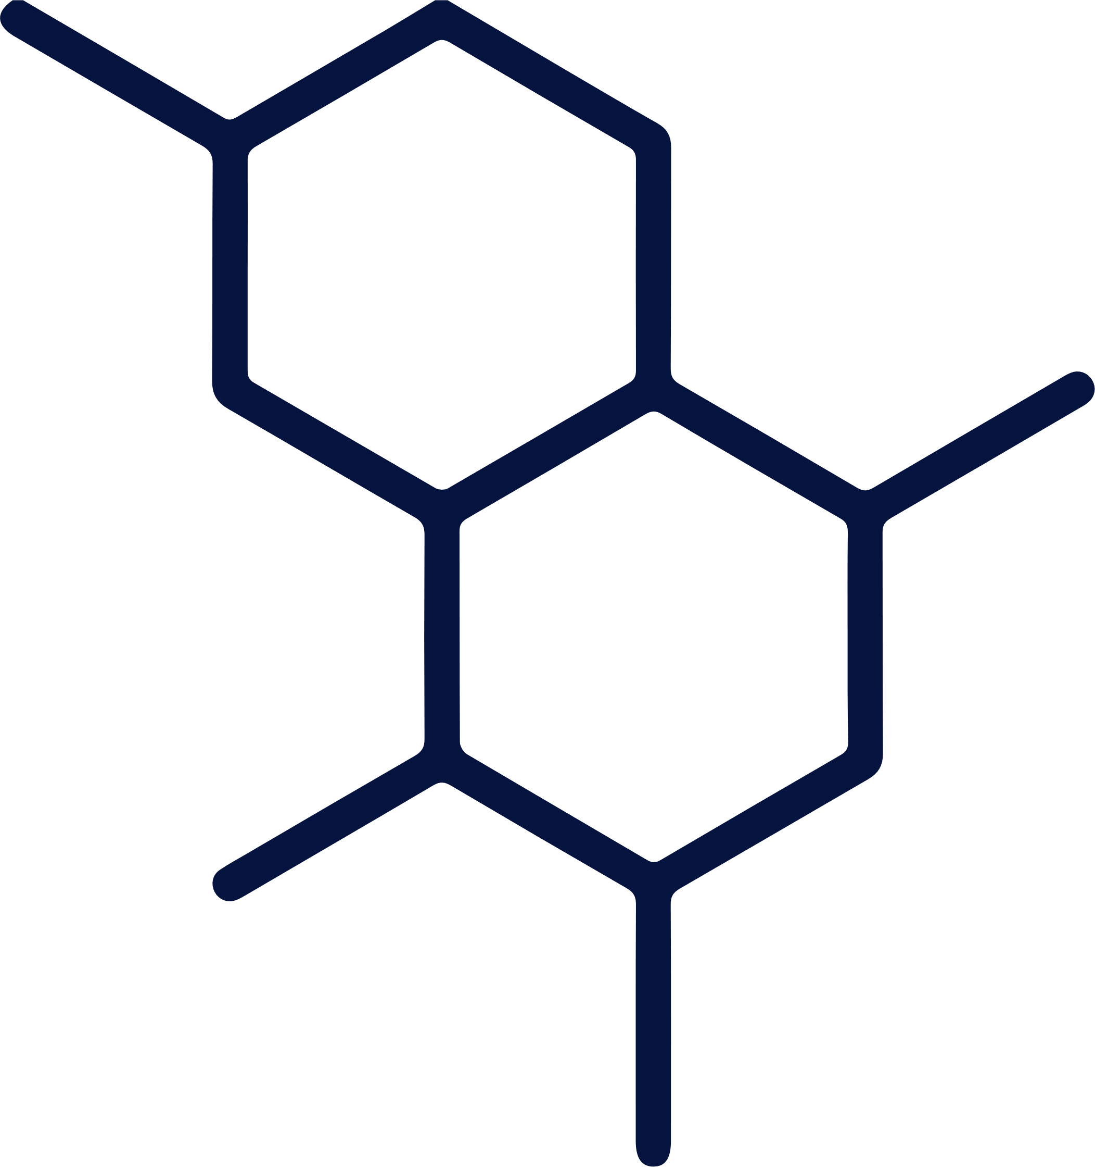
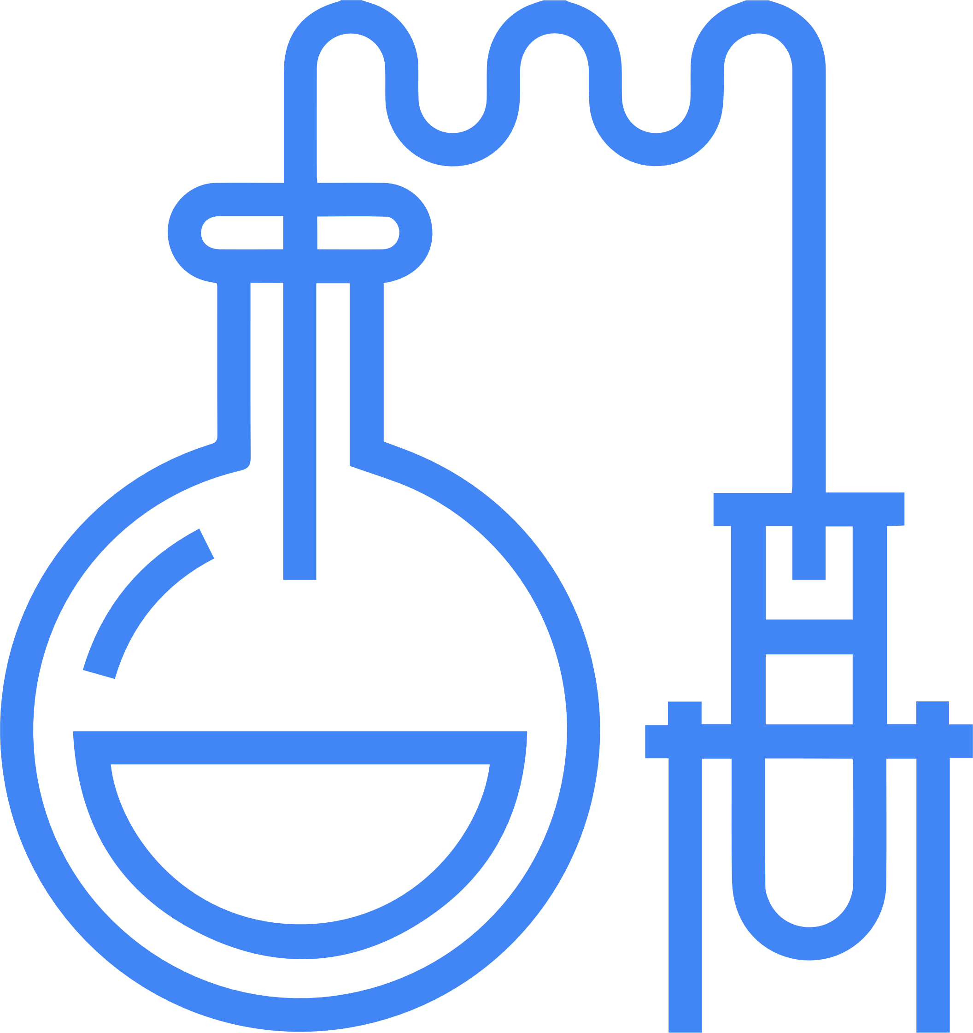
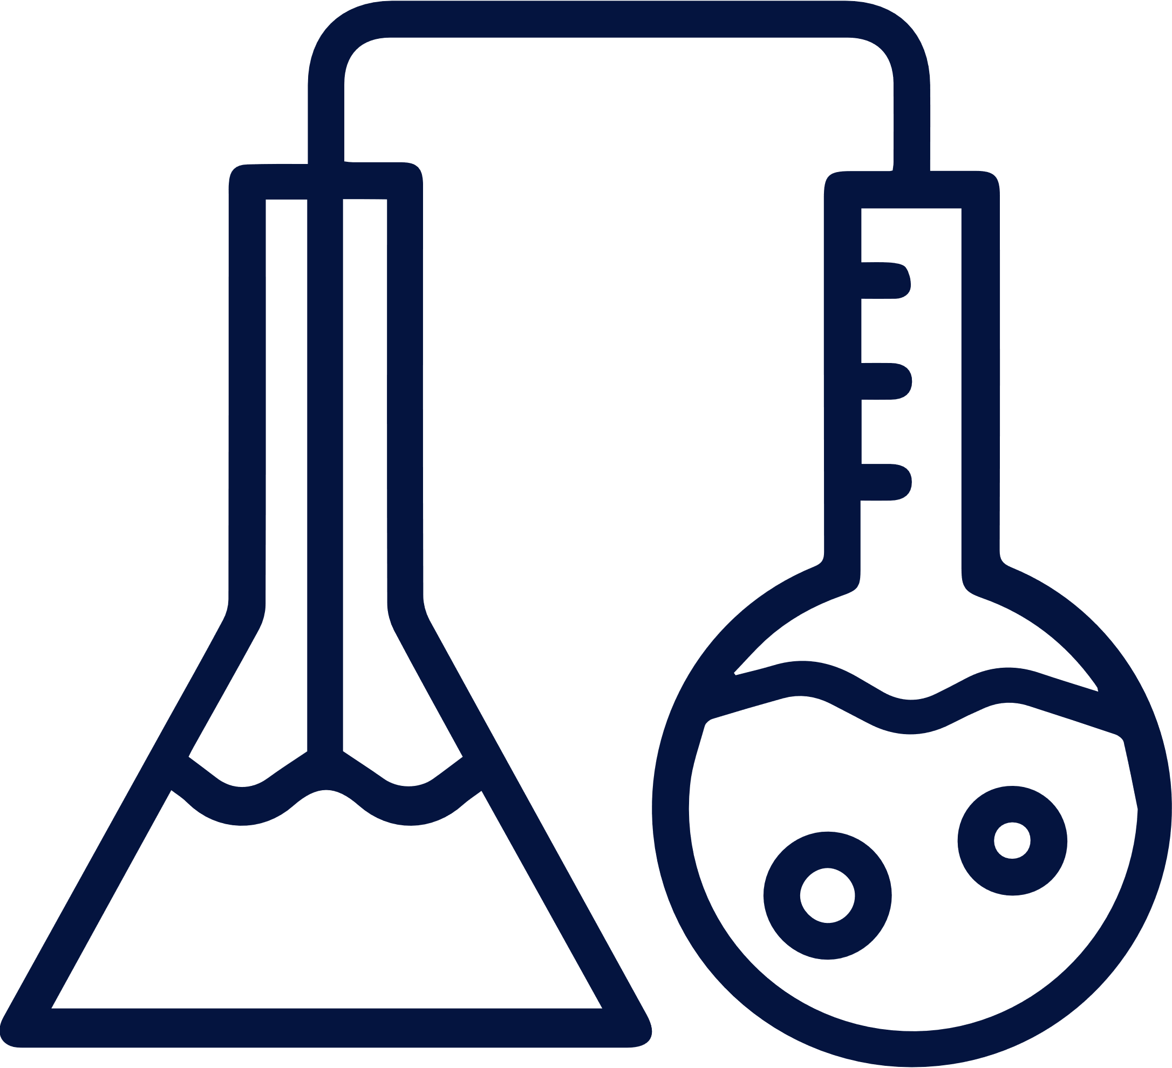


Conclusions/Future Objectives
NTS-104 is a novel water-soluble prodrug that converts rapidly to
NTS-105 in plasma
NTS-105 is a novel, potent neurosteroid that crosses the BBB
NTS-105 has nanomolar affinity for PR nuclear hormone receptors
Administration of NTS-104 following ischemic stroke or TBI in rats improves functional outcomes and lesion volume
NTS-104 administration reduces acute inflammatory mediators and inflamed cerebrovascular endothelial cell markers
Efficacy demonstrated in multiple independent laboratories
and models
NTS-104 is being advanced into
Phase 1 clinical trials in AIS and TBI (2022)
NTS-104 has an issued composition
of matter patent
NTS-104 and NTS-105 have issued method of treatment patents

Slide 18
THANK YOU

Slide 19

Acknowledgements
Don Stein
Michael Chopp
David Poulsen
Barclay Morrison
Dennis Liotta
Zhenggang Zhang
Emory
HFHS
SUNY Buffalo
Columbia University

